Slide 1
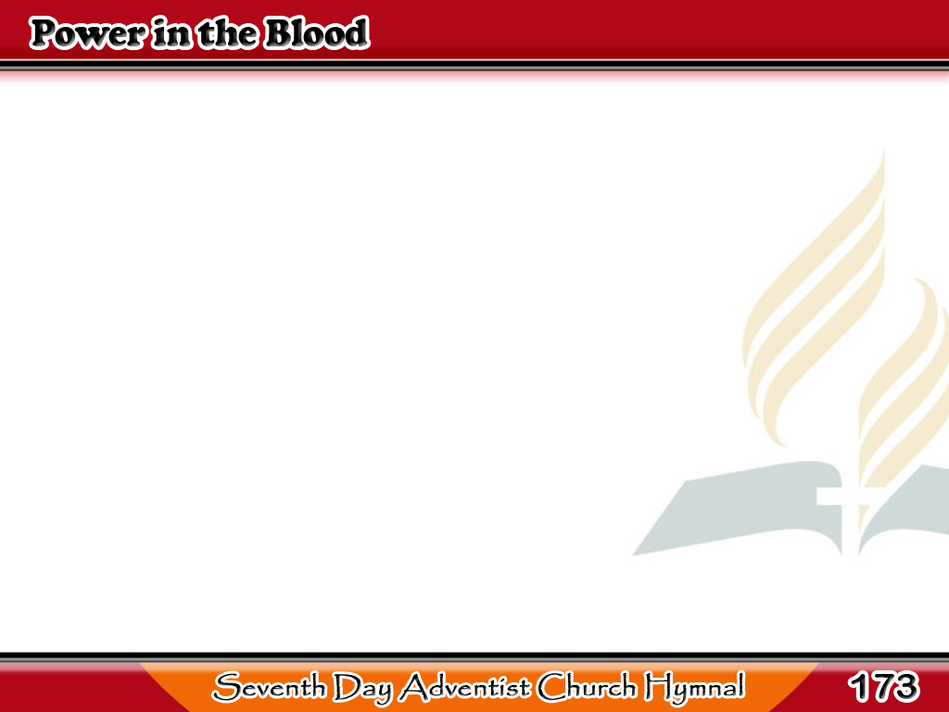
Nais Mo Bang sa Sala’y Maligtas?
Would you be free
from the burden of sin?
There’s pow’r in the blood,
pow’r in the blood;
1/3

Slide 2
Nais Mo Bang sa Sala’y Maligtas?
Would you o’er evil
a victory win?
There’s wonderful pow’r
in the blood.
1/3

Slide 3
Nais Mo Bang sa Sala’y Maligtas?
-Refrain-
There is pow’r, pow’r,
wonderworking pow’r
In the blood of the Lamb;
1/3

Slide 4
Nais Mo Bang sa Sala’y Maligtas?
-Refrain-
There is pow’r, pow’r
wonderworking pow’r
In the precious blood
of the Lamb.
1/3

Slide 5
Nais Mo Bang sa Sala’y Maligtas?
Would you be free from
your passion and pride?
There’s pow’r in the blood,
pow’r in the blood;
2/3

Slide 6
Nais Mo Bang sa Sala’y Maligtas?
Come for a cleansing
to Calvary’s tide?
There’s wonder pow’r
in the blood.
2/3

Slide 7
Nais Mo Bang sa Sala’y Maligtas?
-Refrain-
There is pow’r, pow’r,
wonderworking pow’r
In the blood of the Lamb;
2/3

Slide 8
Nais Mo Bang sa Sala’y Maligtas?
-Refrain-
There is pow’r, pow’r
wonderworking pow’r
In the precious blood
of the Lamb.
2/3

Slide 9
Nais Mo Bang sa Sala’y Maligtas?
Would you do service
for Jesus your King?
There’s pow’r in the blood,
pow’r in the blood;
3/3

Slide 10
Nais Mo Bang sa Sala’y Maligtas?
Would you live daily
His praises to sing?
There’s wonderful pow’r
in the blood.
3/3

Slide 11
Nais Mo Bang sa Sala’y Maligtas?
-Refrain-
There is pow’r, pow’r,
wonderworking pow’r
In the blood of the Lamb;
3/3

Slide 12
Nais Mo Bang sa Sala’y Maligtas?
-Refrain-
There is pow’r, pow’r
wonderworking pow’r
In the precious blood
of the Lamb.
3/3

